Slide 1
Prerequisites
Make sure the following is installed and configured:
Windows 10 as on Mac the solution was not tested
Java 8
Git
Eclipse
Maven
Chrome or Firefox with latest versions

Slide 2
Steps to configure the tests
1. Clone the repository to any location on your computer: https://github.com/vadymbutlerovskyi/DropBoxTestNGAutoTests.git
2. Go to [Location where repo was cloned to]\DropBoxTestNGAutoTests\ SeleniumFramework\src\main\java\config\config.properties and set variable browser to either chrome (default) or firefox
3. Go to [Location where repo was cloned to]\DropBoxTestNGAutoTests\ SeleniumFramework\testing.xml and find the parameters. They can be wisely modified to comply with different purposes.
4. Likewise, the tests can be simply included/excluded or even removed/added within <suite> tag. Please refer to http://testng.org/doc/documentation-main.html

Slide 3
Steps to run the tests
1. Run Command Prompt and switch to [Location where repo was cloned to]\DropBoxTestNGAutoTests\SeleniumFramework\
2. Run mvn compile and mvn test
3. Watch the tests running till the end
4. Check the test report generated at: [Location where repo was cloned to]\DropBoxTestNGAutoTests\SeleniumFramework\extent.html. It comes with dynamic interface, so feel free to browse a complete and detailed test report.

Slide 4
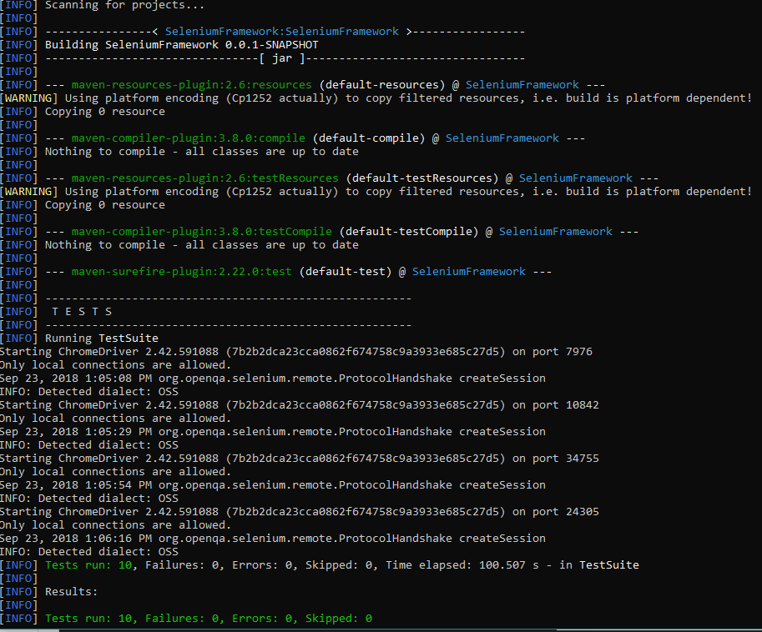
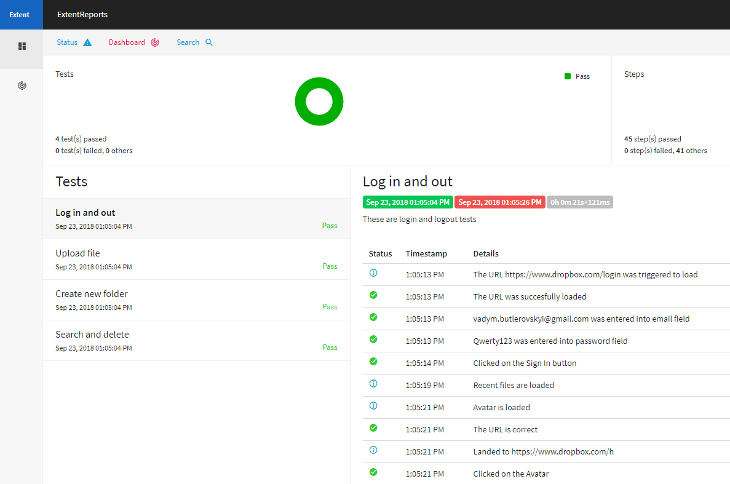
Test results
MAVEN
EXTENT TEST REPORT

